Slide 1
Nlp, Machine learning, Conversational Ai, Alana……
Name: Khan Md Shahedul Islam(2018380130)
Name: Dikhshya Kafle(2018380039)
Duo_Techy
2021/01/05

Slide 2
Overview
Introduction
Objective
Motivations
Alana
Alana Architecture and Design
Overall Performance
Conclusion and Future Enhancement
Alana Architecture and Design
Dialogue State
Alana Services and Updated System Components
Entity Linking
Clarification Service
Individual Bot Classifiers
Response Selection
Fail-safe Mechanisms and Monitoring
System Evaluation

Slide 3
Introduction
A subfield of linguistics, computer science and artificial intelligence, Natural Language Processing (NLP) is concerned with the interactions between computers and human language, in particular with how computers are programmed to process and interpret large quantities of natural language data.
The outcome is a machine that have "understanding" the content of documents, including the qualitative complexities of the language inside them. The program will then reliably extract data and observations found in the documents and categorize and organize the documents themselves.

Slide 4
Introduction
Autonomous robots are intelligent machines capable of performing tasks in the world by themselves, without explicit human control.
Autonomous robots like Alana, Alexa, Siri are made using NLP.
At its heart, Alana is a voice AI that can keep up its side of the conversation with most smart speaker owners for longer than the normal request and answer exchanges. Not only can Alana apply its AI to understand what people are saying, but what it means about the interests and hobbies of that person. That means that in the discussion, Alana will take a more constructive position, proposing new subjects and topics to explore that align with what has already been said. The AI uses multiple sources for its topics of debate, depending on the circumstances. The app can use publicly accessible information, or Alana can connect existing databases to companies and organizations, enabling the AI to exploit unique knowledge.

Slide 5
Objective
The whole purpose is to create an insightful and engaging social chatbot that aims to keep users entertained and for as long as possible to enjoy a spoken conversation on topics of their choosing. A combination of topic-related talk, finding out about the user, and sharing humorous information, jokes, stories, and news items is an overall inspiration for this vision.
Since the system has greater access to web data such as Wikipedia and news articles than human access, the system also offers an entertaining and interactive way to navigate the web/news according to user expectations.
And we have addressed in detail the working processes, priorities and use cases in our paper.

Slide 6
Motivation
During the pandemic, preserving social isolation became a must. The need for artificial intimacy continued to develop. Not only that, for solo explorers, space ship troopers, isolated workers, lonely elderly people and the list continues to go on, artificial companion that can keep conversation at human level is required.
Since the existing state of the art infrastructure for this is not up to the mark yet, tremendous research is taking place and funds are flowing in from major companies such as Amazon, Google, Apple. Since the chance comes with the comprehension of natural language, bots are infinite and promise to put humanity a step ahead.

Slide 7
Natural language processing (NLP)
-A sub-field of Artificial Inteligencie.
-An inner diciplinary subject
Aim:
-To build intellegent computers that can interact with human being like a human being!!

Slide 8
Natural language understandiNg robots :ALANA
Basically, autonomous robots are highly configured and intelligent devices that, without the intervention of human control, are capable of performing certain tasks by themselves.
Robots, for instance, may do things such as chatting, walking, washing, opening doors, etc.
Autonomous robots can make human-like decisions on their own and execute tasks accordingly.
Alana robots is an autonomous chit-chat bot that uses AI technology to continue human-like speech and to learn like human using machine learning algorithm.
This robot ALANA IN BBC was first introduced by Professor Jim Al-khali, who built a computer that can increase, simulate, act like human. He said that the robot uses machine learning and artificial neural network.

Slide 9
Can the robots ALANA really understand?
Yeah, in a way, the robots like Alana is able to understand to some extent and maintain a conversation for 10 minutes or more.
It can communicate like a human being and can react like a human being.
It is a social, artificial intelligence that is able to talk because it is linked to the Internet and can read news as well.
It has its own favorite collections, such as music, movies, books, sports, and it talks about those things that are connected.

Slide 10
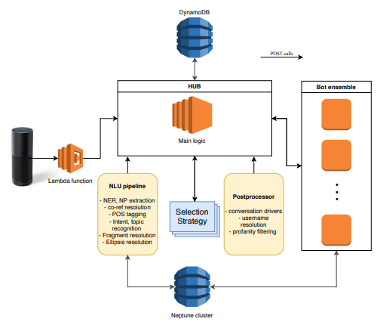
Alana Architecture and Design
As displayed in the image, Alana uses a modular design. A new session starts when the user talks to their devices, and an event object enters the lambda function, which contains the user's utterance text representation, along with some other high-level metadata.

Slide 11
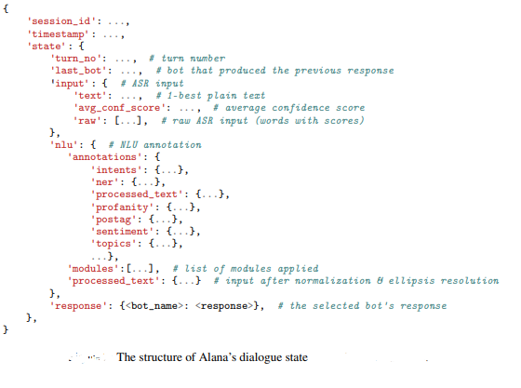
Dialogue state
Supporting an interesting and engaging conversation requires a detailed representation of the current state of the dialogue. For this reason, There is designed a specific context representation for the Alana system aimed at integrating and retaining fundamental information related to the state of the conversation. The structure of the state in each turn is shown in the picture

Slide 12
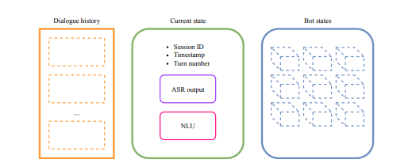
The structure of the state in each turn is seen. The state object encapsulates all the details that the system requires to generate a suitable response for the user at each turn.

Slide 13
Alana Services and Updated System Components
In this section, we focus on the new system components developed for the 2018 Alana version 2
Bot services
-New NLU pipeline:- A fundamental component of the updated architecture for 2018 is represented by a Natural Language Understanding (NLU) pipeline that enhances the current user utterance with specific annotations. The NLU service is responsible for annotating a given text by applying a pipeline P conditioned on the conversation state S. The NLU service is equipped with a set of modules M = {M1, M2, . . . , Mn}. From M a pipeline P can be created. The pipeline is outlined as a list of module units. A module unit is defined as a list of modules that can be executed concurrently. Each module unit is applied sequentially and receives the state object generated in the previous step of the pipeline. In this way, the behavior of each NLP module is conditioned on the state of the conversation..

Slide 14
Entity Linking
Once there is a knowledge base available, in order to retrieve additional information associated with the entities that can be found in it, the system should be able to map a given surface form in the user utterance to an entity in the related knowledge base. This task is known as Entity Linking and it is defined by Shen et al. (2015) as follows:
“Given a knowledge base containing a set of entities E and a text collection in which a set of named entity mentions M are identified in advance, the goal of entity linking is to map each textual entity mention m ∈ M to its corresponding entity e ∈ E in the knowledge base.”
This is an important task in dialogue systems that needs to understand mentions to specific entities in the user utterance: it is fundamental for the system to be able to support a coherent conversation with the user about a specific topic.

Slide 15
Clarification Service
Being able to retrieve specific entities in the user utterance is not always enough to achieve a coherent and engaging conversation. Sometimes for a given surface form there are multiple candidate entities in the knowledge base. This preliminary step in the Entity Linking literature is called Entity Spotting. Instead of relying on a disambiguation procedure that completely ignores the user, there was an implemention of an interactive clarification module. Its purpose is to resolve the ambiguity of an entity interactively by posing a clarification question. This module is composed of several steps that are reported as follows:
1. Identification of ambiguous candidates;
2. Generation of a clarification question;
3. Analyzing the user answer;
4. Clarifying the entity and continuing the dialogue.

Slide 16
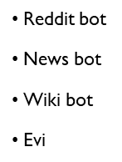
Response Selection
Current selection strategy is defined by a bot Priority List, which dictates which bot should handle the current turn. A bot will only produce a response given a particular user intent, so the turn will be handled by the bot with the highest priority that actually produces a response. The current priority list is as follows, in order:
• Profanity bot
• Fact+Joke bot 7
• Weather bot
• Persona
• Ontology bot

Slide 17
Fail-safe Mechanisms and Monitoring
To maximize availability, the system is designed to be very robust and to provide a reply to the user even under the following adverse circumstances:
• Overload/failure of specific bots in the ensemble: Since all bots are queried for each user input , in many cases multiple bots are able to respond. Therefore, if one or more bots are overloaded or faulty, other bots can handle many queries that would normally be handled by the incapacitated bot(s), providing a lower-quality response. The coherence bot is designed to always provide a reply and will generate generic replies to many common queries, which means that the system as a whole is able to provide an output from one of the bots in most cases.
• Entity linker failure: The entity linker is a separate module used by the NLU as a service . Therefore, in case it fails, the NLU is still able to provide the remaining annotations, which can still be used to provide a reply to the user. The ontology bot relies directly on linked entities, but other bots are in general able to produce responses even if entity linking is not present.

Slide 18
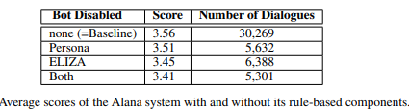
System Evaluation
A/B tests performed to see the effect on the performance of the system of removing/modifying certain components of the system. As a baseline, the average score at the end which is based on user-rated 30,269 dialogues. The scores range from 1-5, 5 being the highest, and are given by users after chatting with the system.

Slide 19
Overall Performance
It was achieved consistently high user ratings and long conversations throughout the period. The final average user score over the whole challenge was 3.4, with an average duration of 2.19 and 11.3 turns. 10 percent of conversations were over 9 minutes long. Uptime for the period was 99%..

Slide 20
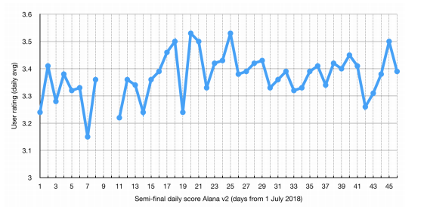

Slide 21
Future Enhancements
There are lanes for a number of improvements to Alana, some of which are new features, and some enhancements of existing ones:
• Improvements to the NLU pipeline: – Better entity linking using an ensemble of FEL and NECKAr15 – Better clarification functionality using the topic of the conversation to filter out irrelevant entities – Improved coreference resolution – Handling Multiple Intents in NLU: at the moment, our NLU pipeline can only handle a single intent/dialogue act per turn, and this often leads to inappropriate responses. – Better ASR error handling
• Multi-turn ontologies + Question Answering: currently Alana’s interactions about particular NEs are shorter than we would like. We plan to extend the Ontology-bot to handle longer stretches of conversation about a particular NE, or set of related NEs, including the ability to answer user questions about these entities.
• Extension of ontology bot to different domains: currently we are in the process of deploying sports ontology live after the semi-finals
• Better Persona responses with opinions about entities (Why do you like Roger Federer?) • Improving recall of our abuse detection model and testing different mitigation strategies
• Improving the precision of the search engine used by Reddit-bot

Slide 22
What are limitation of NLP(Natural Language Processing)?
ONE of the drawbacks of NLP is accent.
For example, a person from Ukraine speaks English, his or her emphasis and pronunciation of words differs from ordinary English people. The NLP's Ukrainian English accent is also difficult to manage.
A weakness of NLP is also machine translation.
For example, there is an regional language Mandarin and to convert Mandarin to other languages sometimes some words are translated incorrectly to other languages .

Slide 23
What are limitation of NLP(Natural Language Processing)?
Nepali
- मेरो नाम दिक्षा हो ！- Englishi- My name is Dikshya.
Google Translation
English-My name is Dikshya! --- Nepali (मेरो नाम दीक्षा काफ्ले छ)
Bengali
- আমার নাম সাহেদ। - English- My name is Shahed
English- My name is Shahed!– Bengali( আমার নাম হল সাহেদ)

Slide 24
What are the challenging problems for the future?
AI is a new digital technology, with the scarcity of experts and qualified people in the future being the biggest obstacle.
Legal concerns are also an important concern that we face in the near future, where we need effective regulations to monitor these sensitive data if AI collects personal sensitive data.
We will be faced with gathering and using relevant information in the future.
We will need massive computational power and sufficient AI resources in the future, we need to develop required computing resources to run large quantities of knowledge and use techniques such as deep learning.

Slide 25
What is the best path for the future?
AI would affect each and every sector of our livelihoods.
It may affect travel, health care, education, media, client services, etc.
AI has been the primary technology for new innovations such as IOT, big data, analytics, etc.
Using AI, humans will be able to communicate in their language of choice with each other.
AI could replace the world's human labor and run faster than human labor.
In chemical factories, in the deep sea and even in mining, space exploration, etc., AI will take over the risky jobs.

Slide 26
Future NLP Possibilities
NLP is one of the most important technology that provides machines with the ability to interpret, understand, evaluate and gather adequate meaning from human languages. Computational Linguistics, which is a synthesis of two technologies, namely Machine Learning (ML) and Artificial Intelligence, is also known as NLP (AI).
The future implementations of Natural Language Processing will be more user-oriented as technology continues to evolve.
Digital assistants, for example, can solve several complex questions along with the literal, which implies the query submitted, analyzing the consequences. Not only are the NLP applications limited to answering consumer problems or providing personalized shopping, they have, however, progressed into a greater kind of technical assistance.

Slide 27
Future NLP Possibilities
Natural Language Processing can be trained to include a list of errors today, if anyone uses NLP to ask, "What's wrong with my network?" ”. NLP will be in a position to find out the real intent of the user in the coming years, as she/he needs continuous access to his/her network.
With NLP, the future is exciting as progress would encourage people to move attention from the questions to the answers. In the exciting days yet to come, NLP will be built-in to company revenues and making them more effective and agile with various innovations such as gesture and facial recognition.

Slide 28
NLP vs. Computer Language
The language spoken and written for communication is a natural language, such as English. Syntax, phonetics, etc. compose the natural language. All natural languages have some basic laws, which are based on the grammar structure. In conversation, these grammatical rules are used by individuals.
Programming languages are used in the development of computer programs that allow certain operations to be performed by a computer. Some syntactic and semantic principles are the core of the structure of these languages. In Java programming, context-free, lexical and syntactic grammar can be used.

Slide 29
NLP vs. Computer Language
The grammar differences between high-level programming languages (for example, Java) and natural languages (for example, English) are as follows:
1. Natural languages are used for human communication and programming languages enable people to communicate with machines.
2. Program languages need a high degree of knowledge, completeness and accuracy because when speaking, any small errors are overlooked, computers do not think beyond the sentence.
3. The syntax of the programming language is not based on the grammar of natural languages.

Slide 30
NLP vs. Computer Language
Therefore, the key distinction between high-level language (Java) and natural language (English) grammar is that natural language can be informal in expression, but not in written communication, whereas strict syntax is followed by programming language grammar.

Slide 31
Conclusions:
Natural Language Processing (NLP) is changing how language-based knowledge is processed and related, by having machines prepared to understand content and perform human tasks such as summary, translation, characterization, and extraction.
In addition, NLP provides companies with a great opportunity to examine unstructured data, including interactions with customer service, product reviews, and social media messages, and gain useful insight into targeted consumers.
The way machines comprehend human language seemed to be impossible a few years ago. In a short time, however, Natural Language Processing (NLP) has become one of the most influential and fastest-growing areas in Artificial Intelligence and Machine Learning.

Slide 32
References:
https://www.ukessays.com/essays/management/programming-language.php
https://s3.amazonaws.com/dex-microsites-prod/alexaprize/2018/papers/Alana.pdf
https://enterprisersproject.com/article/2019/9/ai-explained-plain-english?page=1
https://medium.com/@rinu.gour123/what-is-natural-language-processing-in-artificial-intelligence-b13dc4aa1c81
https://anirudh-m.medium.com/current-applications-and-future-possibilities-of-natural-language-processing-nlp-1d85d4f0bcb6
https://www.alanna.ai/2019/12/how-an-intelligent-agent-with-nlp-can-benefit-a-title-company/
https://voicebot.ai/2020/03/17/alana-debuts-a-conversational-ai-with-plenty-to-discuss/
https://www.scotsman.com/news/heriot-watt-university-developing-robot-capable-conversation-humans-1425094
https://observer.com/2020/08/breakthrough-a-i-companion-robots-will-adapt-to-your-personality-help-the-elderly/

Slide 33
https://sites.google.com/site/hwinteractionlab/
https://alanaai.com/what-makes-alana-different/
https://alan.app/
https://blog.alana.ai/en/gpt3-processamento-linguagem-natural
https://en.alana.ai/skills/reports
https://d7qzviu3xw2xc.cloudfront.net/alexa/alexaprize/assets/pdf/2018/Alana.pdf
https://developer.amazon.com/alexaprize/challenges/past-challenges/2018
https://spring-h2020.eu/wp-content/uploads/2020/05/SPRING_D10.3_Privacy-and-Ethics-Guidelines_VFinal_30.04.2020.pdf
https://arxiv.org/ftp/arxiv/papers/1801/1801.03604.pdf

Slide 34
Thank You!

